Slide 1

^{STRANGE R THINGS}

Slide 2
Getting started with R
Data Wrangling and Basic Principles
Gabriele von Eichhorn, MSc BSc BA Elisabeth Rothe, Dipl.-Psych.
IQS – Institut des Bundes für Qualitätssicherung im österreichischen Schulwesen
RLadies, 24.04.2024

Slide 3

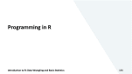

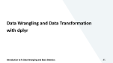
















Slide 4

First things first…

Slide 5
Beschreibung
In recent years, the programming language and statistical software R has increasingly become the scientific standard, gradually complementing or replacing other programs. The workshop offers an introduction to R. First, basic principles such as the language itself, R packages, objects, functions and data structures are introduced. Then, with the help of practical exercises in the program R-Studio, simple calculations and the use of functions will be taught. Data import and export from different common formats as well as the most important techniques of data preparation (sorting, filtering, recoding, creating new variables,...) will be covered. The calculation of basic descriptive and inferential statistical methods is covered as well as the presentation of results in graphs or tables.
If the participants wish, in the last part the learned topics can be deepened or other topics, such as loops, writing own functions or useful packages (e.g. tidyverse, data.table) can be touched. "Help for self-help" is an important principle of the workshop. The goal is to give the participants useful resources and strategies to be able to continue working and learning R on their own after the workshop.
The workshop is aimed at people who want to gain a general insight into working with R and therefore does not require any previous knowledge of programming. The statistical basics of the covered content are not part of the workshop and are assumed. For active participation it is necessary to bring your own laptop.

Slide 6


Who are we?
Elisabeth Rothe
Diploma (MSc) in Psychology in Munich
Psychometrician at BIFIE/IQS since march 2018
During my studies a seminar with R (still without RStudio)
Experience with other programming languages
Learning on the job (from other people, scripts, books, internet…)
Gabriele von Eichhorn (Gabi)
MSc in Psychology and BA in Education Sciences in Salzburg
psychometrician at BIFIE/IQS since march 2018
Introductory course to R in my master’s studies → analysed my theses with R → some more introductory courses → learning by doing at IQS
Notes:
„Lots of people call me a psychometrician – I realise that that sounds more like an insult than it does a job title but what it means that I study psychological metrics and in particular I‘m interested in educational test scores. I‘m interested in how we design and use educational test scores and how we might design and use educational test scores better than we currently do, for parents, for teachers, for students, for school leaders, for policy makers and for educational researchers.“ Andrew Ho: https://www.youtube.com/watch?v=qKFDLp3IXvM Kurz: Psychologin, die mit Daten arbeitet. Lang: Ich beschäftige mich damit, wie man Fähigkeiten und Kompetenzen misst, also wie man Tests designt, anwendet und auswertet, und wie man deren Ergebnisse nutzt, um Schüler/innen, Eltern, Lehrpersonen, Schulleitungen und Politiker/innen einen Informationsgewinn zu bieten.

Slide 7
What are we doing with R (at work and otherwise)?
Data Wrangling / Data Preparation
Exploratory Data Analysis (EDA) and Plots
Reporting (PDF and HTML)
Sampling
Psychometrics & Statistics
(as a side effect: folder management on Windows, creating directories, copying, pasting, renaming,… files)
(Web Apps / Shiny Apps)
Notes:
Portfolio-Time :-D

Slide 8

Materials
https://github.com/squirrellina/Getting-started-with-R

Slide 9

small survey
https://www.menti.com/j4xzhwprkt
menti.com → Code 6308 9997

Slide 10
Survey (I)
How would you judge your previous experience with:
Statistics
1: descriptive statistics –
3: linear regressions –
5: multidimensional multilevel models
Programming
1: formulas in Excel –
3: SPSS syntax –
5: R/Python/SAS/Stata
R / RStudio
1: never opened on own account –
3: opened before, have executed ready-made code –
5: have written code by myself

Slide 11
Survey (II)
I want to learn / I am especially interested in…
Data Wrangling / Pre-Processing
Descriptive Statistics
Inference Statistics
Plots and Visualisation
Reporting (with RMarkdown/Quarto)
Web Applications with Shiny
Programming & Writing Custom Functions
Debugging
…

Slide 12
And now a little more personal…
Who are you, why are you here, what‘s your job?
What do you do with data? What do you want to do with data? Which kind of data do you work with (qualitative, quantitative, text data, survey data, assessment data,…)?
What do you know about R? What have you heard/learned/read/seen on the internet about R? What makes you curious?

Slide 13
Workshop Goals (specific and abstract)
You…
know RStudio
understand objects and functions in R and how they look
know different types of objects and data structures
can read and edit data from different common formats
can wrangle data for the most common use cases
can look at basic descriptive statistics
have a basic representation of two R dialects (base and tidyverse)
We want…
to give a general insight into the R language and RStudio as a GUI
to motivate – show possibilities – put aside reservations
to provide tools, tips and tricks for learning
to build up resources for self-help to avoid situations like in the cartoons ☺

Slide 14
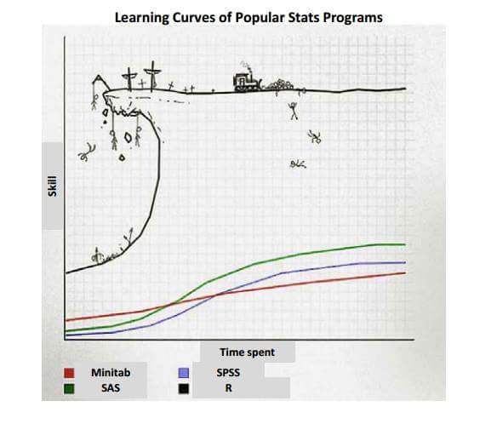
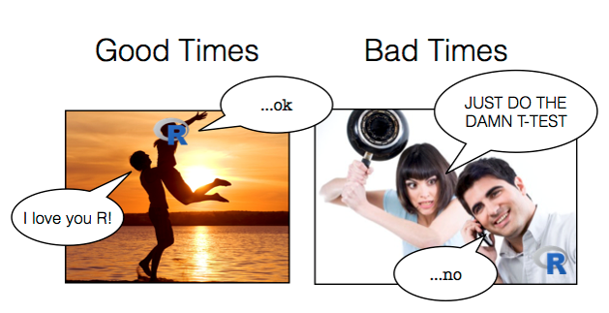

Slide 15
Info
Workshop is mostly derived from:
„R in 10 Schritten – Einführung in die statistische Programmierumgebung“ von Rainer W. Alexandrowicz
„R in Action“ von Rob Kabacoff
„YaRrr! The Pirate‘s Guide to R“ von Nathaniel D. Phillips

Slide 16

First steps

Slide 17
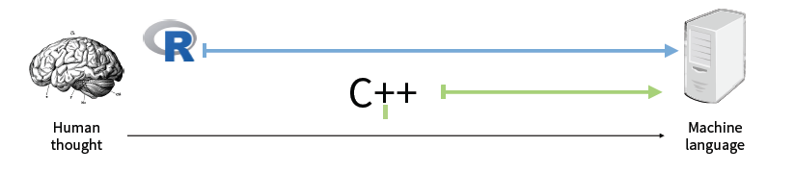
What is R?
a programming language and programming environment for data analysis and graphics
an open source software
Graphik from McNamara (2019)

Slide 18
Why R? Advantages
Open Source
active community, great support system
flexible & versatile, all in one solution
expandable
100% free
reproducible & transparent

Slide 19
R kann alles (… man muss nur wissen wie) ☺
R can do everything (… you just have to know how) ☺
Notes:
Zitat Manuel Wick

Slide 20
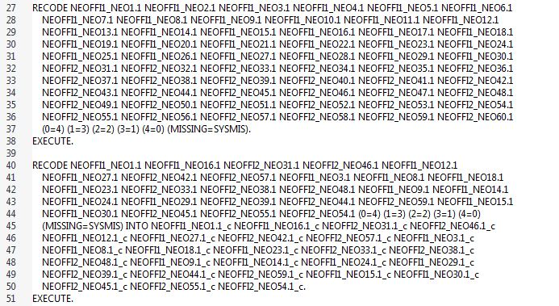
If you‘ve been working with SPSS…
apply(data[, grep(„NEOFFI", names(data))], 2, car::recode, "0=4;1=3;2=2;3=1;4=0;else=NA")
Notes:
SPSS-Syntax aus Gabis empirischem Seminar an der Uni

Slide 21
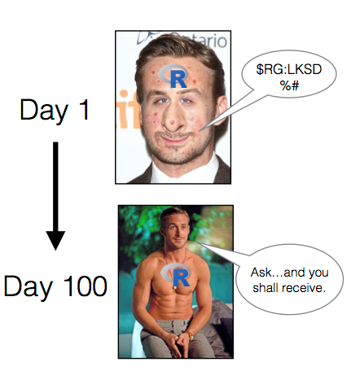
Why not R?
There‘s no guarantee for correctness: R is free software and comes with ABSOLUTELY NO WARRANTY. → BUT: standard packages are developed by experts and are sufficiently tested. Source code can be viewed, which is not always the case with commercial software.
Learning R requires time and a basic motivation for programming. → BUT: You learn basic logic and calculation steps of statistical methods.
Data input is possible in R, but not recommended. → BUT: Data can be read in effortlessly from e.g. Excel.
R is an interpreter language (code is not compiled), which can lead to loss of speed with large amounts of data. → BUT: Interface to C/C++ allows efficient programming (and speed compared to SPSS is blazing...)
R does not provide a GUI (Graphical User Interface). → BUT: If you want one, there are some packages that provide one (or you start using Jamovi/JASP which are GUIs that are similar to SPSS but based on R and open source)

Slide 22
In summary
PRO:
more freedom
CON:
more freedom

Slide 23
R history (from Ligges, 2006)
1992: Project is started by Ross Ihaka und Robert Gentleman (1996)
1993: first binary version appears on Statlib.
1995: R is published under the General Public License.
1997: R Development Core Team (R Core Team for short) is founded.
1998: The Comprehensive R Archive Network (CRAN) is founded.
1999: first conference DSC (Distributed Statistical Computing) in Vienna
2000: The first version R-1.0.0 fully compatible to the S language in version 3 is released.
2004: first R user conference (useR!) in Vienna; R-2.0.0 is released.
July 2023: the most recent version is R-4.3.1 („Beagle Scouts“)

Slide 24
R literature (free)
Nathaniel D. Phillips „YaRrr! The Pirate's Guide to R“
https://bookdown.org/ndphillips/YaRrr/
very playful and easy to read, good exercises
Hadley Wickham und Garrett Grolemunds „R 4 Data Science“
https://r4ds.had.co.nz/
all in one with Tidyverse
Datacamp
https://www.datacamp.com/
Hands-on, guided exercises in the browser (introductory courses are free of charge, otherwise it’s a subscription service)
Auf Deutsch:
Wikibooks GNU R https://de.wikibooks.org/wiki/GNU_R
Statistik mit R und RStudio https://www.produnis.de/R/index.html
Kieran Healys „Data Visualization - A practical introduction“
http://socviz.co/
detailed introduction to R and ggplot2
Robert I. Kabacoff „R in Action“ https://www.manning.com/books/r-in-action 1. edition should hopefully still be free
Notes:
(hier überspringen oder als Referenz anführen, aber nicht durchnehmen)
YaRrr finde ich persönlich gut - leicht lesbar und alle wichtigen Infos drin, dieser Workshop orientiert sich strukturell an diesem Buch. Die Kapitel sind häppchenweise abzuarbeiten und enthalten am Ende immer einen 'Test your R might'-Teil mit nützlichen Übungen.
Mit zweiterem kommt man sehr weit - es ist allerdings darauf hinzuweisen, dass in dem Buch eine leicht veränderte Sprache als in diesem Workshop verwendet wird, das sogenannte Tidyverse. Es ist aber ein sehr beliebtes und umfassendes Buch und immer empfehlenswert, es in einem Browserfenster geöffnet zu halten. Außerdem wird es immer auf dem aktuellen Stand gehalten – momentan wird an der nächsten Version geschrieben, die während dem Schreibprozess schon einsehbar ist. Hadley Wickham ist eine der Legenden der R-Community.
Datacamp würde ich jedem empfehlen: das ist eine Online-Plattform zum Lernen von verschiedenen Kompetenzen im Data-Science-Bereich. Die Instructor sind sehr renommiert und die Kurse sind didaktisch sehr gut aufbereitet. Wer sich mit Üben schwertut, kann vielleicht mit dem Belohnungssystem etwas anfangen. Man muss sich registrieren und kann dann jeweils die ersten Kapitel der Kurse kostenlos absolvieren. Mit einem Abo (nicht günstig) hat man vollen Zugriff auf Kurse, Projekte, Career Tracks und die mobile App zum Üben. Falls man sich für ein Abo entscheidet: es gibt häufig Angebote, bei denen das Abo dann um die Hälfte günstiger ist.

Slide 25
Reference books
R Reference Card (https://cran.r-project.org/doc/contrib/Short-refcard.pdf)
RStudio Cheatsheets (https://www.rstudio.com/resources/cheatsheets/)
Quick-R (https://www.statmethods.net/)
R Cookbook (http://www.cookbook-r.com/)
Tidyverse Style Guide (https://style.tidyverse.org/) / Google's R Style Guide (https://google.github.io/styleguide/Rguide.xml)
R Markdown (https://bookdown.org/yihui/rmarkdown/)
Programming: “Advanced R” (http://adv-r.had.co.nz/)
Packages: “R Packages” (http://r-pkgs.had.co.nz/)
Text Mining: “Text Mining with R” (https://www.tidytextmining.com/)
Notes:
Die R Reference Card kann man sich sehr gut ausdrucken und neben die Tastatur legen, um ein schnelles Nachschlagewerk zu haben, bis man die Grundbefehle auswendig kennt. Ebenso die Cheatsheets: das sind aufbereitete Informationen zu verschiedensten Themen und Packages. Quick-R ist von einem R-Lehrbuch-Autor (Kabacoff von R in Action), der sich dem Lehren verschrieben hat. Scheint meistens als einer der ersten Treffer auf Google auf und ist sehr hilfreich. Das R Cookbook von Winston Chang ist dem Zweck gewidmet, Lösungen und Code zu häufigen Problemen anzubieten. Auf den Style Guide geh ich später noch ein. Markdown ist eine Möglichkeit, ganze Reports in R zu schreiben und als PDF, HTML oder PPT zu exportieren. Advanced R und R Packages sind Bücher von Hadley Wickham, die mehr aufs Programmieren und Packages veröffentlichen ausgerichtet sind.

Slide 26
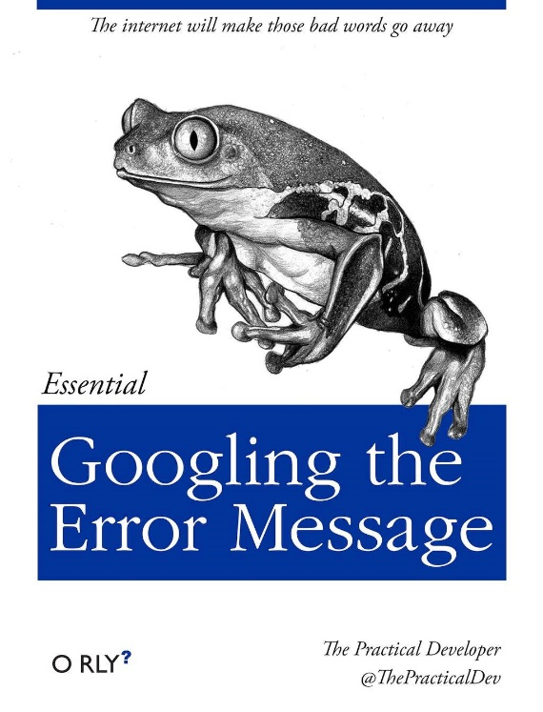
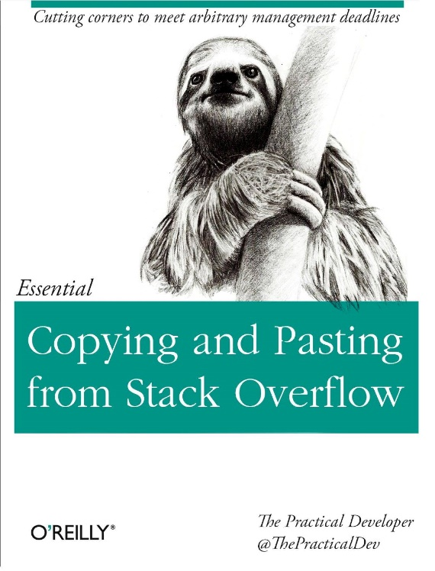
more specific
for specific problems:
documentation (https://www.rdocumentation.org/)
search engine (https://rseek.org/)
blogs (https://www.r-bloggers.com/)
StackOverflow (https://stackoverflow.com/)

Slide 27
Resources to get inspired
https://www.r-graph-gallery.com/ (plots + code)
https://rmarkdown.rstudio.com/gallery.html (R Markdown documents in various output formats and designs)
http://shiny.rstudio.com/gallery/ (various Shiny web applications + code)
https://twitter.com/hashtag/rstats (what's happening in the community? new packages, visualizations and memes ;-))
Youtube: David Robinson oder Julia Silge (Tidy Tuesday Screencasts → preparation, exploration and analysis of new datasets)

Slide 28

Getting started

Slide 29


Getting started
Installation:
install R: https://cloud.r-project.org/
install RStudio: https://posit.co/download/rstudio-desktop/

Slide 30
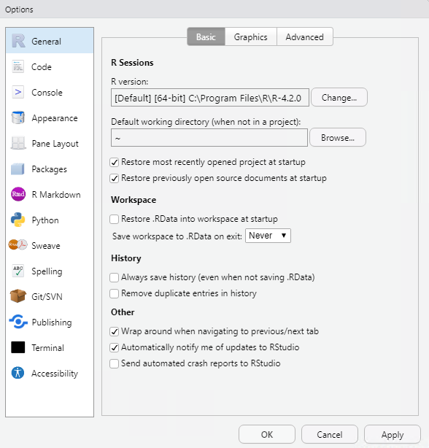
Set up RStudio – Basics
Tools > Global Options > General
de-select „Restore .RData into workspace at startup“ & „Save workspace to .RData on exit“ to „Never“ (https://rstats.wtf/save-source.html)
„Always save history“: is needed very rarely (most important code is in the script)
Tools > Global Options > Code
Rainbow Parentheses
Native Pipe Operator?
Text Encoding?
Notes:
https://rstats.wtf/save-source.html
Why? To establish a reproducible workflow from the beginning → everything that‘s important is saved into the script, everything that takes long is saved into a file. It‘s a way of forcing oneself to have a disciplined coding experience Warum? Um von Anfang an einen reproduzierbaren Workflow zu etablieren → alles, was wichtig ist, wird ins Skript gespeichert, alles, was lange dauert, wird zwischengespeichert.
Hier RStudio aufmachen alle zusammen und schauen, ob es funktioniert

Slide 31

Set up RStudio – Make yourselves at Home
Tools > Global Options > Appearance
Editor Theme – dark or bright?
Tools > Global Options > Pane Layout
Console on the right side or below? (controversial opinion: most screens are wider than they are high → it‘s easier to look from left to right than from up to down)
I tend to prefer the console on the right side, when I have a larger screen and down when I‘m working on a laptop

Slide 32
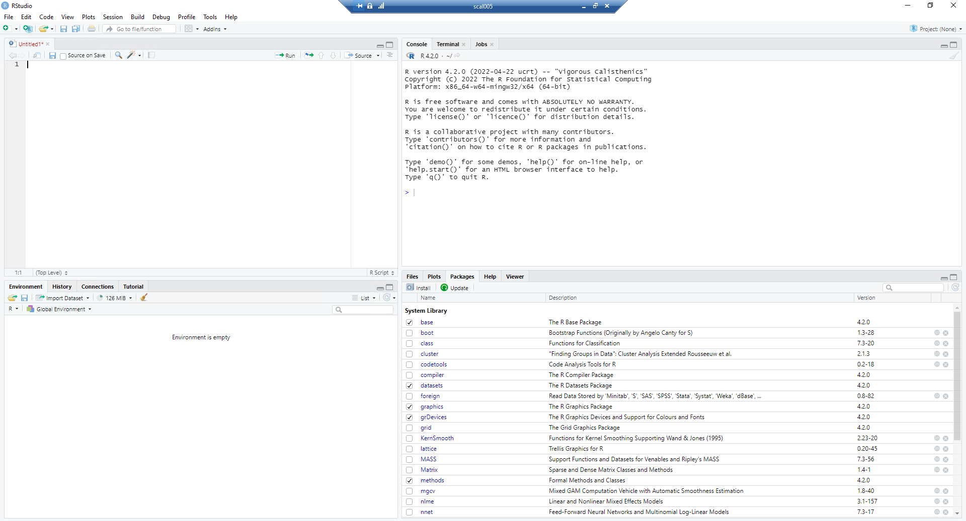
Script Editor
(Source)
Console
Files, Plots,
Packages,
Help,…
Environment,
History
Notes:
https://bookdown.org/ndphillips/YaRrr/the-four-rstudio-windows.html

Slide 33
Here code is written and saved to a script!
The code is not executed until it is sent to the console
(Ctrl + Enter or „Run“)
Script Editor
(Source)
Enter
Strg

Slide 34
The console executes code.
Here you can see executed code and its‘ results.
The console is also useful for quick calculations that do not need to be saved. The code is then executed with Enter.
Console

Slide 35
Here you can see which objects are stored in the workspace (Environment) or which code has already been executed (History).
Environment,
History

Slide 36
Here are some help functions: you can…
navigate directories (Files),
look at plots (Plots),
get an overview of installed R packages (Packages) and the
look up R help (Help)
Files, Plots,
Packages,
Help,…

Slide 37
Mechanism of Programming in R
Everything that exists is an object.
Everything that happens is a function call.
Writing, executing and stopping code
Code is written to the script editor and executed with Ctrl+Enter or "Run".
In the console the code is executed by only pressing Enter.
Commands go until all brackets are closed – they may span multiple lines.
The execution of code can be stopped by pressing Esc or the Stop sign (top right of the console).
(1) define objects, (2) execute functions on those objects, (3) rinse and repeat!

Slide 38
Language basics – what‘s important?
Upper and lower case: object, Object, oBjEcT and OBJECT are all different objects and will be treated differently by R
Decimal separator: period instead of comma (difference between c(3,4) and c(3.4))
object names: may not begin with a number and may not contain spaces: my.object, my_object, myobject, MyObject
comments start with a #: everything to the right of the # will not be interpreted by R
<- means assignment: the term on the right of the arrow is assigned to the object on the left of the arrow (x <- 5)
Notes:
hash, pound sign (Zaun, Hashtag)

Slide 39
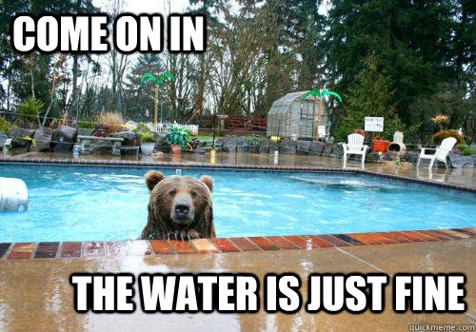
Jumping In

Slide 40

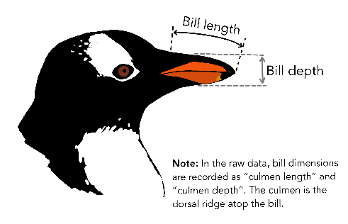
Palmer‘s Penguins
open script: „00_Jumping_in.R“
script contains some explorations on a dataset with penguin data
https://allisonhorst.github.io/palmerpenguins/
Gorman KB, Williams TD, Fraser WR (2014). Ecological sexual dimorphism and environmental variability within a community of Antarctic penguins (genus Pygoscelis). PLoS ONE 9(3):e90081. https://doi.org/10.1371/journal.pone.0090081
Notes:
Skript öffnen, alle führen den Code zusammen aus, müssen aber nichts selber schreiben

Slide 41
Basics: Objects

Slide 42
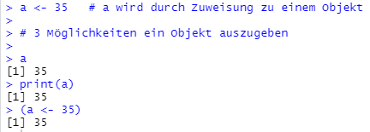
What are objects?
Everything in R is an object (strictly speaking). There are simple objects (e.g. vectors, data frames) and complex objects (e.g. results from statistical methods)
Objects are created and put in the environment by assigning something with the assignment symbol / arrow (<-). You can view available objects with the function ls().
Objects can be addressed without quotation marks.

Slide 43


Assignment operator <-
my_object
function(x)
❷ and put it in this box.
❶ calculate the term on the right
in R: my_object <- function(x)

Slide 44
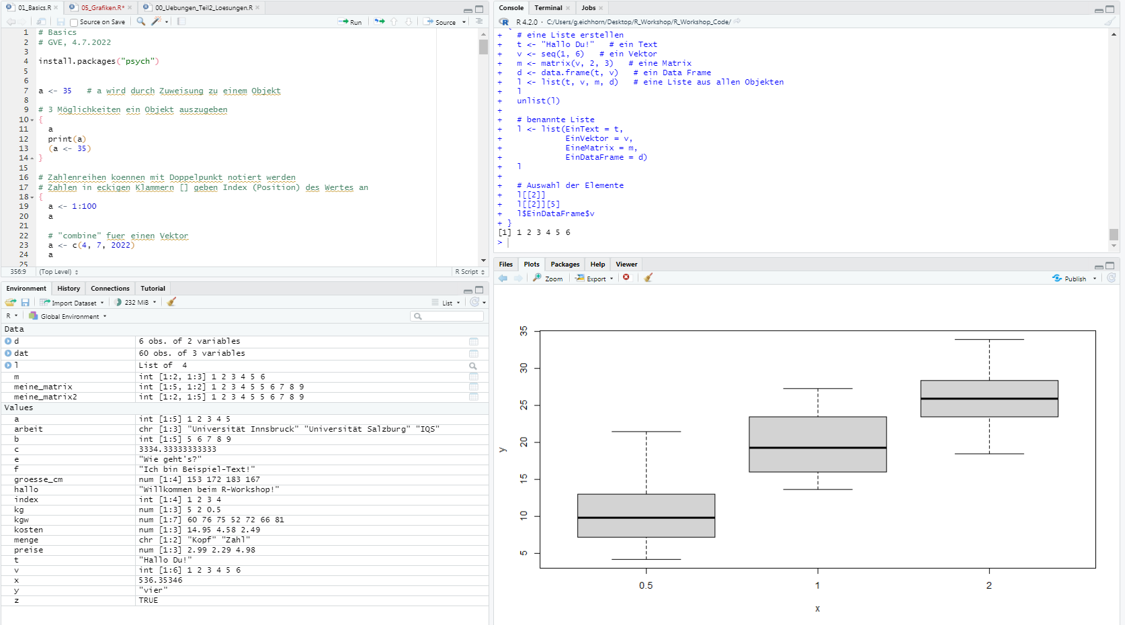
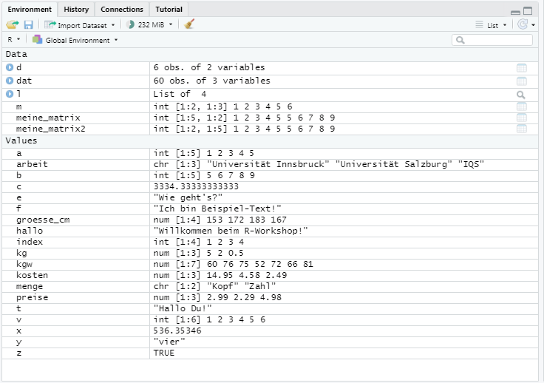





Objects are put in the environment
Objects in the environment can be displayed in the console, …
print( )
processed further and …
+ 5
saved into different or the same objects.
<- + 5

Slide 45
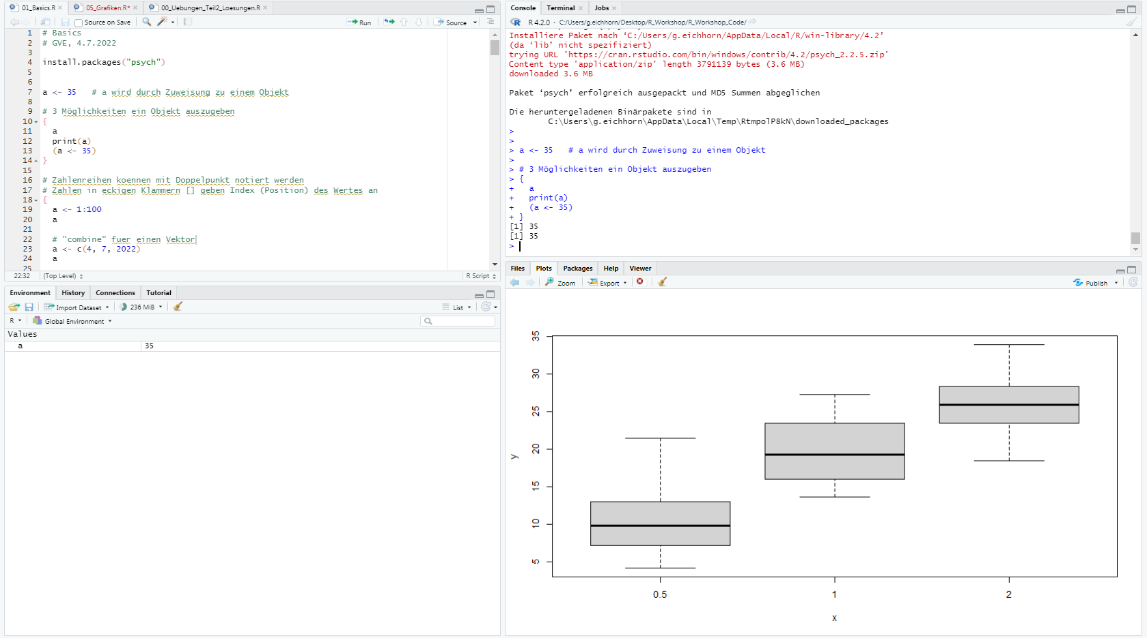

Saving objects to the environment
a <- 35
a

Slide 46
Saving AND printing objects at the same time
a <- 35
(a <- 35)
a
a

Slide 47
Printing objects
a <- 35
(a <- 35)
a
print(a)
→ if things are displayed only in the console and are not visible in the environment, you have to assign them
a

Slide 48
Exercise – Object Names
Create a new R script. Write your name, the date and "Exercise script“ in comments at the beginning of the script. Here you can work on your exercises!
Which of the following object names are valid / invalid? Try to guess first and then try out what happens if you assign something to these object names. (see slide 47 for help)
thisone <- 1
THISONE <- 2
1This <- 3
this.one <- 4
This.1 <- 5
This/One <- 6
ThIS…ON…E <- 7
This!On!e <- 8
lkjasdfkjsdf <- 9

Slide 49
Exercise – Object Names (solution)
Create a new R script. Write your name, the date and "Exercise script“ in comments at the beginning of the script. Here you can work on your exercises!
Which of the following object names are valid / invalid? Try to guess first and then try out what happens if you assign something to these object names. (see slide 47 for help)
thisone <- 1
THISONE <- 2
1This <- 3
this.one <- 4
This.1 <- 5
This/One <- 6
ThIS…ON…E <- 7
This!On!e <- 8
lkjasdfkjsdf <- 9

Slide 50
Exercise – Assignments
Which calls are valid and what do they do (try to guess first if you’re already advanced):
d <- 123 -> e
pi <= 3.14
a = b = c = 567 -> x -> y -> z
x <- (5 + 2)
2 + 1 <- 3
3klang <- „c-e-g“
klang <- „c-e-g“
( x <- 5 + 3 )
zz <- 13; zz + 1
5 <- 3
5 < -3

Slide 51
Exercise – first calculations
Calculate:
2.6 + 5.8
(7 - 10.78) / 5
2^5
Check:
6 == 10
(3 * 5) > (9 + 1)
Create and calculate:
a = 2
b = 5
c = a + b
Take a look at this code: What will R return after the third line?
a <- 10
a + 10
a

Slide 52
Exercise – Types of objects
Create a variable for your first name, one for your last name and one for your birthplace.
How long is your last name (how many characters)?
Using paste() combine your data (name, birthplace) to an appealing output ("My name is ..., I was born in ...") The last name should be displayed completely in capital letters.
Replace the first two letters of your first name with an X.
Create a query: Is your first name the same as your last name?
Create another variable for your height in cm. Check if you are shorter than 172 cm.

Slide 53
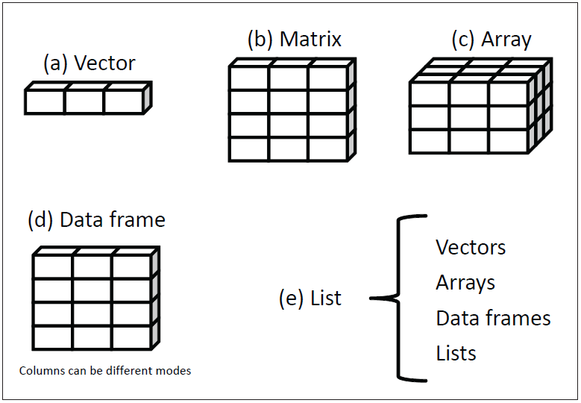
Data structures
aus Kabacoff, 2011

Slide 54
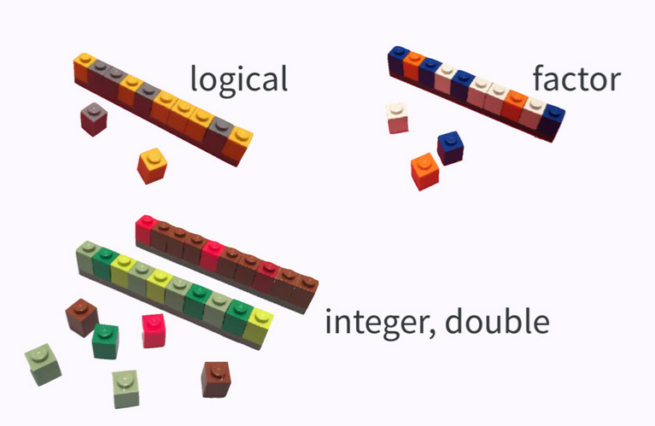
aus „Data Rectangling“ von Jenny Bryan, 2018

Slide 55
Matrices
A matrix is a two-dimensional object → Rows and columns, similar to an Excel spreadsheet
contains only data of the same type
is created with the function matrix()
can be accessed by square brackets [ ] with a comma to select rows and columns respectively
my_matrix[rows, columns]

Slide 56
Indexing matrices
my_matrix[3, 2] corresponds to the 3rd line in the 2nd column
my_matrix[row, column]
[1, 1] | [1, 2] | [1, 3] | [1, 4]
[2, 1]
[3, 1] | [3, 2]
[4, 1]
[5, 1]

Slide 57
Indexing matrices
my_matrix[3, 2] corresponds to the 3rd line in the 2nd column
my_matrix[3, ] corresponds to the entire 3rd line
my_matrix[row, column]
[1, 1] | [1, 2] | [1, 3] | [1, 4]
[2, 1]
[3, 1] | [3, 2] | [3, 3] | [3, 4]
[4, 1]
[5, 1]

Slide 58
Indexing matrices
my_matrix[3, 2] corresponds to the 3rd line in the 2nd column
my_matrix[3, ] corresponds to the entire 3rd line
my_matrix[ , 2] corresponds to the entire 2nd column
my_matrix[row, column]
[1, 1] | [1, 2] | [1, 3] | [1, 4]
[2, 1] | [2, 2]
[3, 1] | [3, 2]
[4, 1] | [4, 2]
[5, 1] | [5, 2]

Slide 59
Data Frames
Data frames are the most important data structure for statistical analysis and most similar to the data structure in e.g. SPSS
most of the time you will not enter data manually into R, but load it from existing files (Excel, SPSS, ...)
Base R comes with preinstalled datasets, with which you can run code examples (library(help = „datasets“))

Slide 60
Well-known datasets
iris (150 observations, 5 variables)
Petal length and width for 3 species of irises (data by Edgar Anderson, 1935)
mtcars (32 rows, 11 variables)
Fuel consumption and other automobile characteristics for 32 automobiles (from the 1974 Motor Trend US Magazine)
ToothGrowth (60 observations, 3 variables)
Tooth length of guinea pigs in different experimental conditions (Vitamin C dose * method of administration)
ChickWeight (578 rows, 4 variables)
Weight of chicks at multiple measurement time points, by diet condition
nycflights13::flights (336776 rows, 19 variables)
Arrival and departure information for all New York airports flights in 2013
palmerpenguins::penguins (344 rows, 8 variables)
Measured values of 344 penguins from different islands and species

Slide 61
Exercise – Data Frames
You are planning a grocery trip and make a shopping list in R. Create a data frame with the columns Product, Department and Quantity.
You would like to purchase the following products (quantity in brackets): Saft(4), Paprika(1), Zwiebel(2), Banane(1), Apfel(3), Ananas(1) and Bier(2). Assign these products to the respective department in the supermarket: beverages, fruits and vegetables.
You are cycling to the supermarket and want to know which products may be very heavy. Therefore, have the data frame output so that only the products drinks are displayed anymore.
Create a new column “more_than_2” in the dataset which indicates with 0 whether the quantity is less than 2 and with 1 whether the quantity is greater than or equal to 2.

Slide 62

Basics: Packages

Slide 63
Packages („Packerln“)
With the start of R, base R is loaded: a mixture of different packages containing most of the basics (base, stats, graphics, utils, datasets, methods, grDevices)
If you want to use more functionalities, you can download and activate additional packages.
An R Package is a compilation of (usually specific to one topic):
Data
Functions
Help pages
Vignettes / Examples

Slide 64

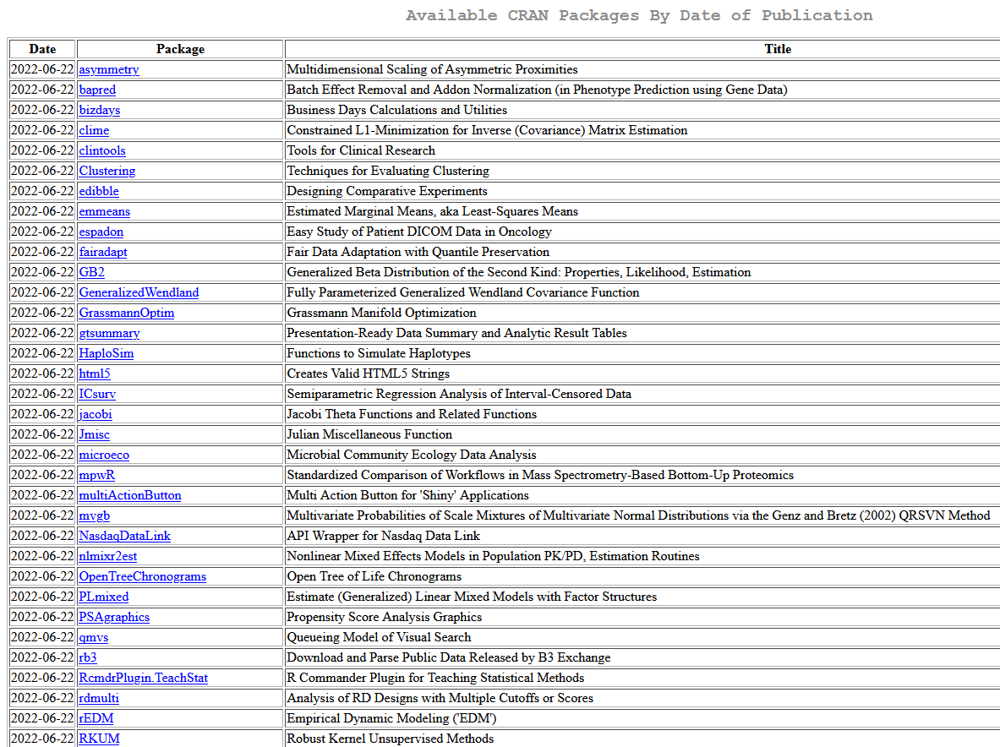
Packages
Packages are like books that you buy and put on the shelf (install.packages()). You can access the contents only when you take out the book and put it on the desk (library()).
Notes:
https://cran.r-project.org/;
18350 Packages Stand 3.7.22

Slide 65
Using packages (I)
1
2
Download the package from CRAN;
1x per computer / user
loads / activates the package
1x per R session
Notes:
https://ipub.com/dev-corner/apps/r-package-downloads/
http://www.datasciencemeta.com/rpackages

Slide 66
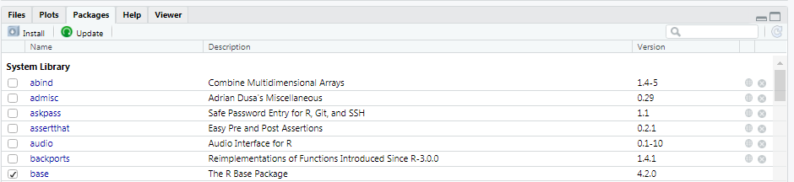
Using Packages (II)
install via „Install“; activating via the checkbox of the package
loading packages should rather be done via code (library()), because otherwise your code might not be replicable by others or errors in the code may occur
Tip: pacman::p_load() installs and activates at the same time – works really well when cooperating with others (who might not have the same packages as yourself)

Slide 67
Functions

Slide 68
Functions
Everything that happens is a function call (in R).
Functions are processes :
The function takes one or more objects,
does something with them and
then gives something back.

Slide 69
Standard structure of functions*
Arguments of the function, separated by commas, in the form:
„name of argument = value that I want“
Package
base::mean(x, trim = 0, na.rm = FALSE, …)
open and closed parentheses
name of function
* Some functions do not have this form, e.g. operators like + and ==.

Slide 70
Dealing with functions
The order of the arguments is defined in the function. If the arguments are used in the stored order, their names do not have to be mentioned. Many arguments have default values, these also do not have to be named.
These variants all lead to the same result (recommended is in the correct order + arguments mentioned):
mean(x = my_vector, trim = 0, na.rm = FALSE)
mean(my_vector, 0, FALSE)
mean(my_vector)
mean(na.rm = FALSE, trim = 0, x = my_vector)

Slide 71
Digression: Conventions for comprehensible functions
When writing functions oneself :
Name functions with verbs and arguments with nouns
data arguments first, then detail arguments
data arguments:
x, y, z for vectors
df for data frames
i, j for indices
n for length or number of rows
p for number of columns
for more information: https://r4ds.had.co.nz/functions.html, https://www.datacamp.com/courses/writing-functions-in-r
Notes:
Bemerke: die meisten base-Funktionen folgen nicht dieser „Konvention“. x steht hier häufig für den Haupt-Input, egal, welche Form dieser hat

Slide 72
Exercise – Functions
Create a variable values_r_erfahrung from all responses to the question „Vorerfahrung mit R/RStudio“.
Calculate the mean value from the values and store it in the variable mean_r_erfahrung.
Calculate the mean value excluding the extreme 20%.
Add a number to the mean value so that the mean value ends up being 5.
Notes:
Übung ist nur zum Ausprobieren, es geht nicht um Ergebnisse. Einfach ein- mal ein bisschen in Konsole und Editor eingeben und schauen, ob RStudio soweit eingerichtet ist und ob alles funktioniert

Slide 73
Seeking help in R!

Slide 74
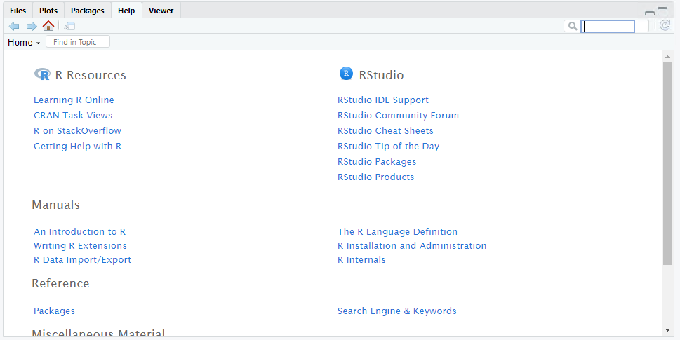
R Help
help.start()
?foo, help(“foo”), highlight function and press F1
??foo, help.search(“foo”)
example(“foo”)

Slide 75
Reading help pages
Description: short description
Usage: form and arguments of the function, variants
Arguments: details on the arguments (e.g. which input they expect)
Details: can include anything and everything
Value: meaning of the output/return statement of the function
Authors: authors
References: books, articles for further reference
See Also: references to related R functions
Examples: executable code for the function

Slide 76
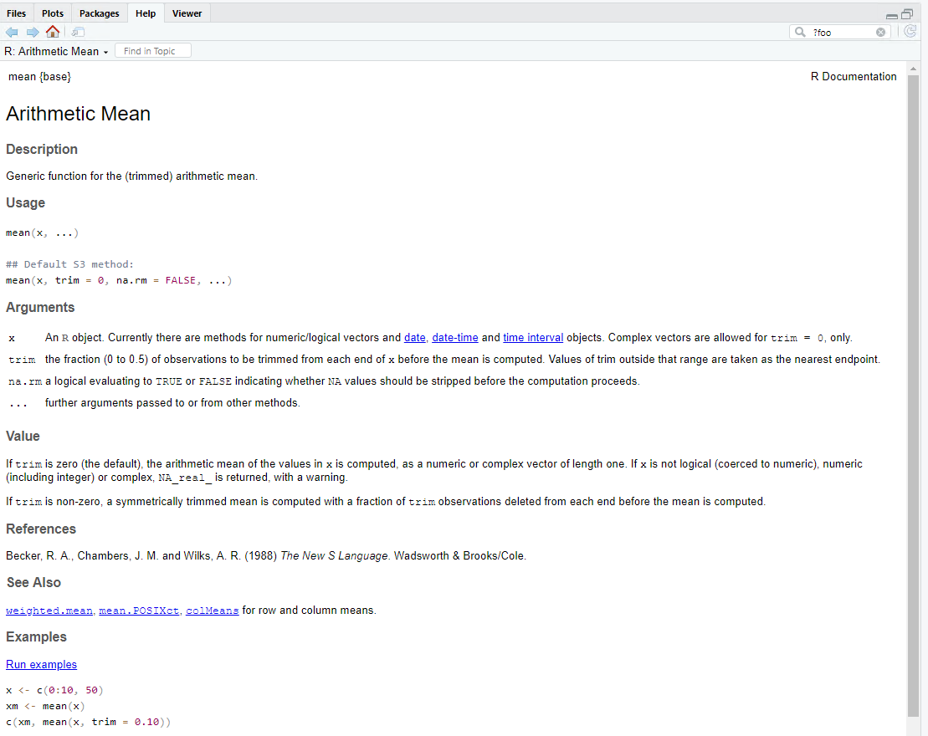
Function {Package}
How is the function defined?
What do the arguments expect?
What does the function return?
Reproducible examples

Slide 77
Mini Quiz – Type conversion
What is the result of this function (use help function, then try it out)?
as.logical(0:5)
What is the result of this function?
as.numeric(as.logical(0:5))
Notes:
Rätselzeit

Slide 78
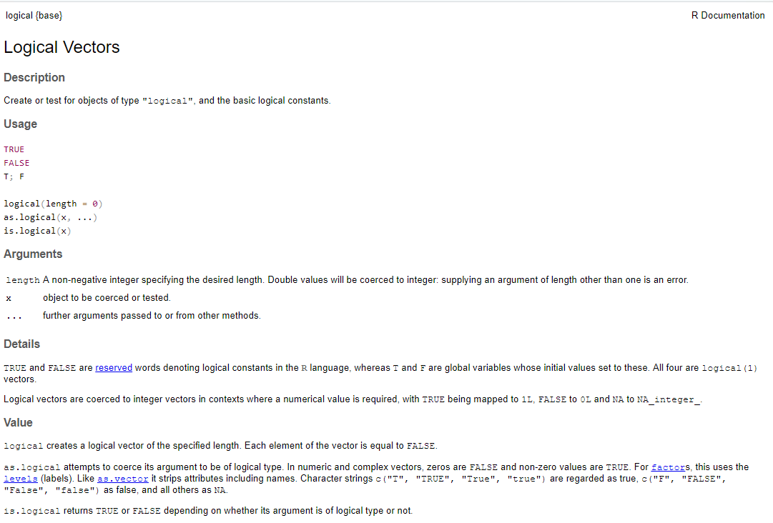

Slide 79
Tips for Googling
R alone is an ambiguous term for Google. In most cases, search terms work anyway when using the pattern „r how to …“. „rstats“ or „r programming“ are good search terms as well.
some tips and tricks:
google in English (!!!)
Add package and / or function names, e.g. „r how to recode variables with car recode“
if possible - specify preferred R dialect in search query: „r how to … in base“, „r how to … in tidyverse / dplyr“, „r how to … in data.table“
try different synonyms and guess functions; use R terminology (columns, rows, vectors, logical, numeric, character, data frame, matrix, list, factor, console, loop, regex…)

Slide 80
further tips for Googling
Enter error messages directly into Google „r object of type closure is not subsettable“
look up reference books and then google their suggested functions or terms (https://r4ds.had.co.nz/index.html, http://www.cookbook-r.com/)
Blogs often provide general step-by-step instructions, StackOverflow and forums tend to provide solutions for very specific issues
rseek.org, if Google does not show R specific search results

Slide 81
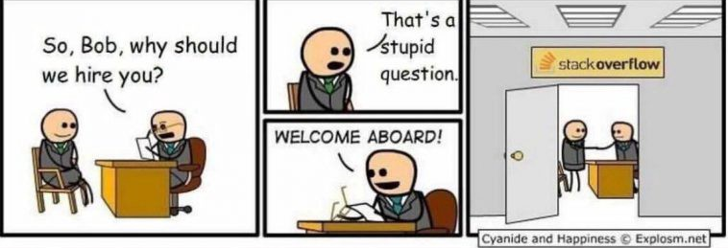
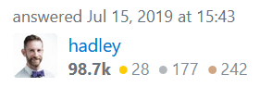
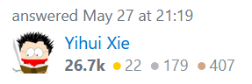
Tips for StackOverflow
StackOverflow is a platform for software developers that allows users to ask and answer questions.
Contrary to what the cartoon says, the R community on StackOverflow is very eager and friendly ☺
Often there are different approaches to the solution, so the chance of success is greater and you can get to know other programming styles.
There are clear guidelines for "reproducible examples“ (reprex) → if the situation cannot be reproduced by the respondents, the question is not answered.
Bonus: From time to time you can also find answers from the package developers themselves!
Notes:
https://stackoverflow.com/questions/57023442/translating-dplyr-to-data-table/57043135#57043135 https://stackoverflow.com/questions/72243968/plain-code-chunks-for-r-input-in-knitr-output/72411178#72411178

Slide 82
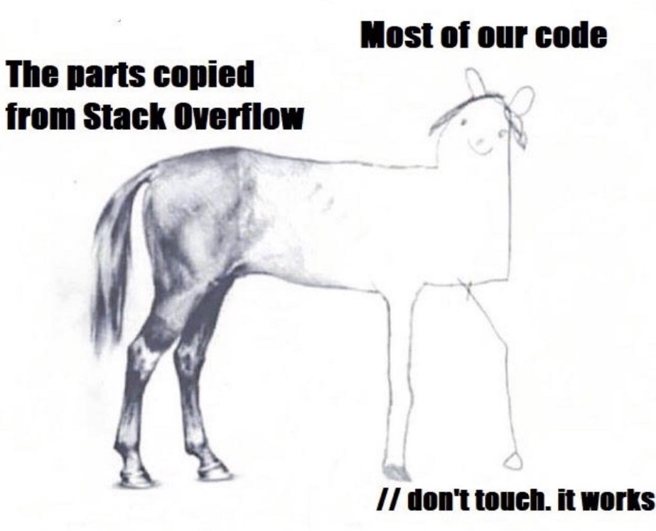
How to read StackOverflow?
https://stackoverflow.com/questions/14543627/extracting-numbers-from-vectors-of-strings/38712300#38712300
The answers get upvotes from other users and one answer is often accepted as the best answer
I often look at the best answer and its rating first, and then evaluate whether the question helps me. Sometimes the question doesn't cover exactly what you are looking for, but the answer is still useful.
Notes:
Link zusammen anschauen und Antworten durchgehen

Slide 83



Base R vs. Tidyverse

Slide 84
Code comparison
Base R style | Tidyverse style
head(dat) | dat %>% head()
dat$variable | dat %>% select(variable) dat %>% pull(variable)
dat[dat$sex == "female", "height"] | dat %>% filter(sex == "female") %>% select(height)

Slide 85
Data Wrangling and Data Transformation
with dplyr

Slide 86
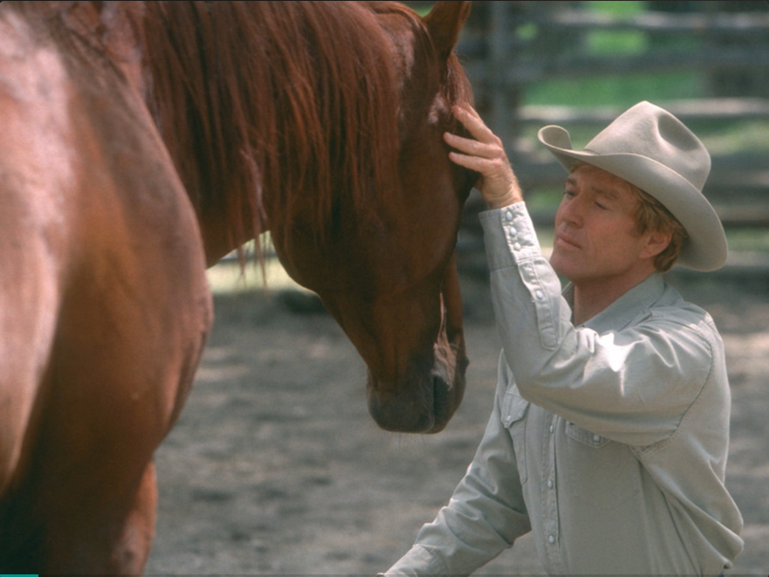
„Data Rectangling“ von Jenny Bryan, 2018

Slide 87
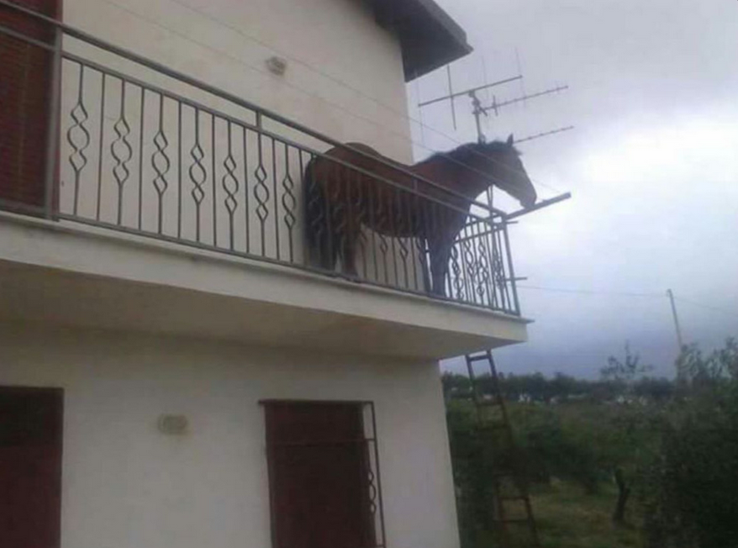
„Data Rectangling“ von Jenny Bryan, 2018

Slide 88

„Data Rectangling“ von Jenny Bryan, 2018

Slide 89
Data Wrangling / Data Transformation
filtering
arranging
selecting
making new variables
creating summaries

Slide 90

dplyr (Tidyverse)
For data preparation and exploration the package dplyr is very popular. It contains the functions:
select() → selecting columns
filter() → filtering
mutate() → creating new variables
arrange() → sorting
summarise() → creating summaries
count() → data summary
case_when(), case_match() → recode variables
tidyr::pivot_longer(), tidyr::pivot_wider() → reshape data
For an introduction: https://youtu.be/Gvhkp-Yw65U; https://r4ds.had.co.nz/
Notes:
länger, aber etwas veraltet: https://youtu.be/jWjqLW-u3hc

Slide 91
dplyr (Tidyverse)
Other functions:
count() → data summary
Notes:
länger, aber etwas veraltet: https://youtu.be/jWjqLW-u3hc

Slide 92
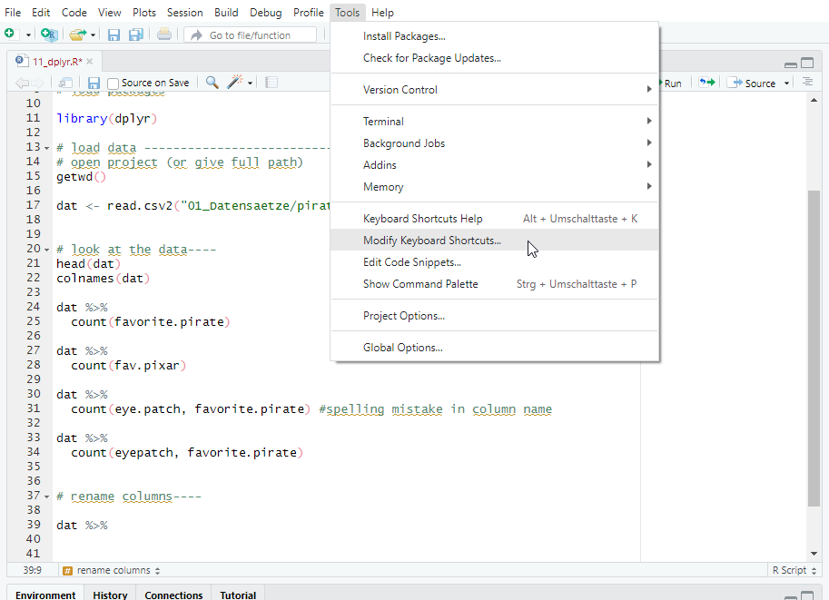
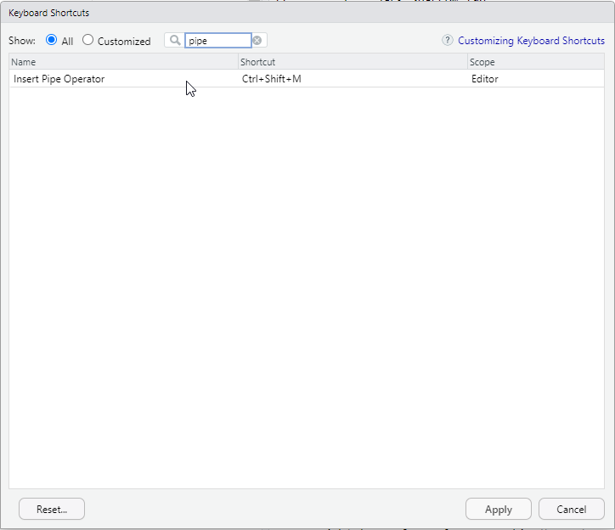
Preparations in RStudio: Shortcut for pipe %>%

Slide 93
Preparations in RStudio

Slide 94
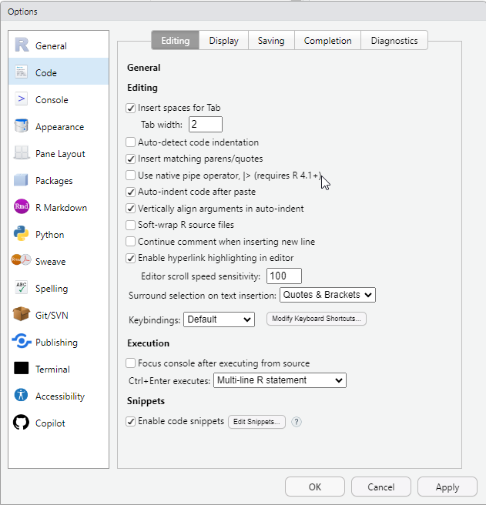
Default pipe

Slide 95
Packages
dplyr
tidyr:: pivot_wider, tidyr::pivot_longer

Slide 96
Reshaping Data

Slide 97
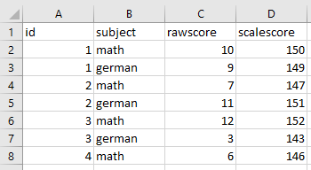
From long-format to wide-format

Slide 98
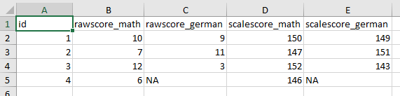
From long-format to wide-format

Slide 99
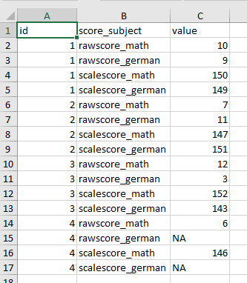
„Even longer“ format

Slide 100
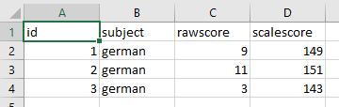
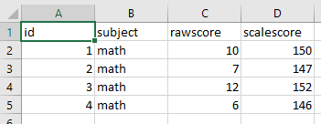
Several datasets (or a list)

Slide 101
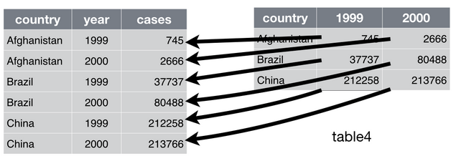
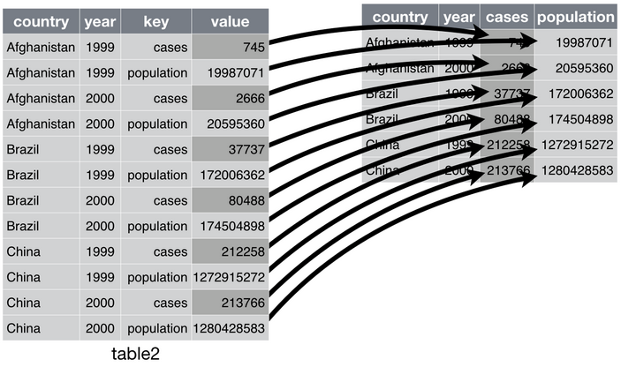
Advanced Data Wrangling – Reshaping
datasets in an incorrect format that need to be restructured (with the functions tidyr::pivot_wider() or tidyr::pivot_longer() )

Slide 102
Best Practices

Slide 103
Best Practices
Style Guide
Aufbau R-Skript
Aufbau Ordnerstruktur

Slide 104
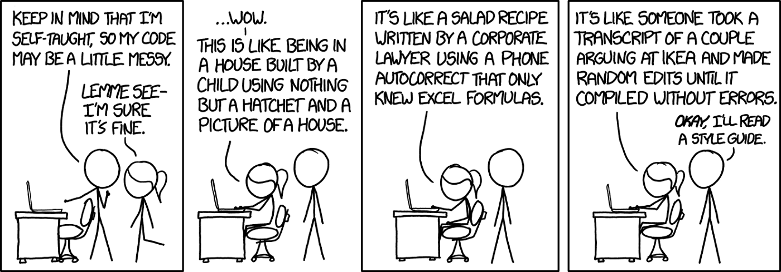
Style Guide (Vol. I)
https://xkcd.com/1513/
Notes:
https://xkcd.com/1513/

Slide 105
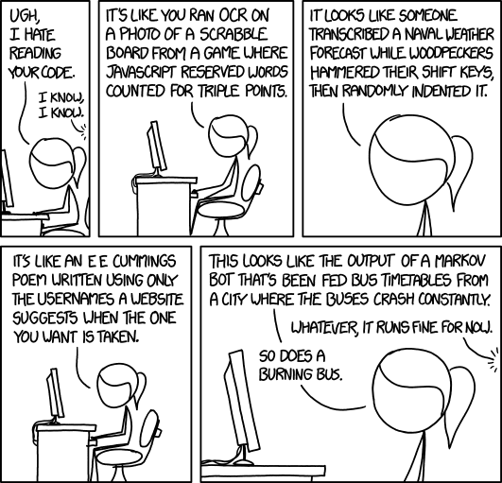
Style Guide (Vol. II)
https://xkcd.com/1695/
Notes:
https://xkcd.com/1513/

Slide 106
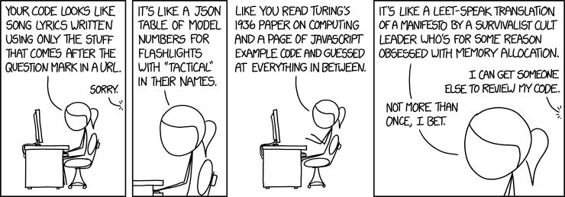
Style Guide (Vol. III)
https://xkcd.com/1833/
Notes:
https://xkcd.com/1513/

Slide 107
Why Style Guides?
Code should be readable for computers AND humans!
A few simple measures:
Headings with ####, ----, ==== or Code > Insert Section (Ctrl+Shift+R), optical separators, e.g. #****
put sections in { } – that way they can be carried out section by section, are indented and visually easy to recognize
Comment: R lines are free, so be sure to use them to comment your code
Spaces: put spaces around =, ==, +, -, <- and after commas
line breaks: when the line gets too long (80 characters as a guideline)
choose meaningful object names : find balance between „df“ and „March2015Group1OnlyFemales“
Notes:
https://style.tidyverse.org/index.html
Folie 38 / Yarrr

Slide 108
Even more Style Guide!!!
https://style.tidyverse.org/index.html
Object names with underscores (periods are already reserved for base functions, methods and class names).
Variables = Nouns; Functions = Verbs
no function names as object names (T, F, c, mean, …)
Name arguments if the default is not used (z.B. mean(x, na.rm = TRUE))
Use <- for assignment (not =)
„“ instead of ‚‘
write TRUE and FALSE instead of T and F
for long function calls, put each argument and the parentheses on a separate line
https://google.github.io/styleguide/Rguide.html (Addition to Tidyverse Guide)

Slide 109
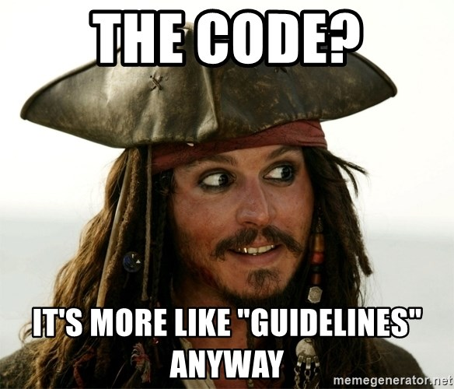
Notes:
Style Guide sind Richtlinien: man nehme sich, was man sicher durchhalten kann. Überschriften, Leerzeichen und Kommentare sind sehr wichtig, der Rest ist optional

Slide 110
Shortcuts in RStudio
Shortcut | Function
Strg + Enter | Execute code from the script
Strg + Alt + B | Run code from beginning to this point
Strg + Shift + C | Comment out code (#)
Strg + I | Indent code
Strg + Shift + D | Duplicate line of code
Strg + Shift + R | Insert section
Strg + Shift + M | Insert pipe (base or dplyr, depending on the setting in Options)
F1 | Help (for highlighted function) = ?funktion
Strg + F | Search
Strg + Shift + F10 | R restart (useful for a reset if problems occur)

Slide 111
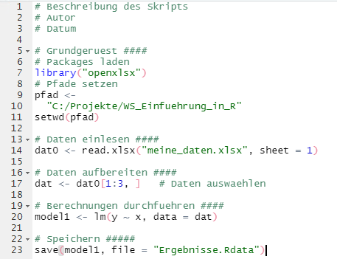
Structure of R scripts
Basic Framework
Read data
Prepare data (+ exploration)
Calculations (+ plots?)
Save

Slide 112
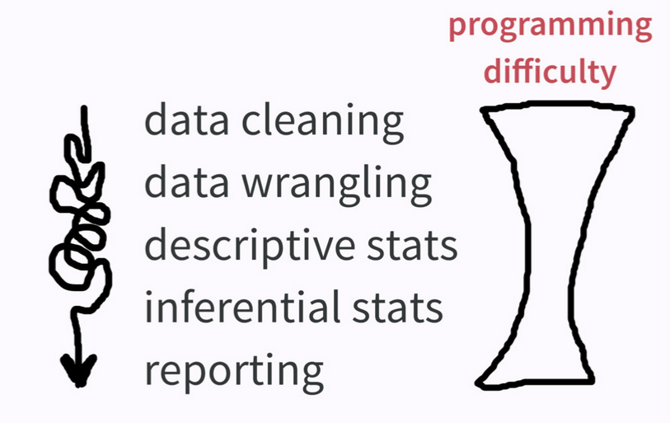
„Data Rectangling“ von Jenny Bryan, 2018

Slide 113
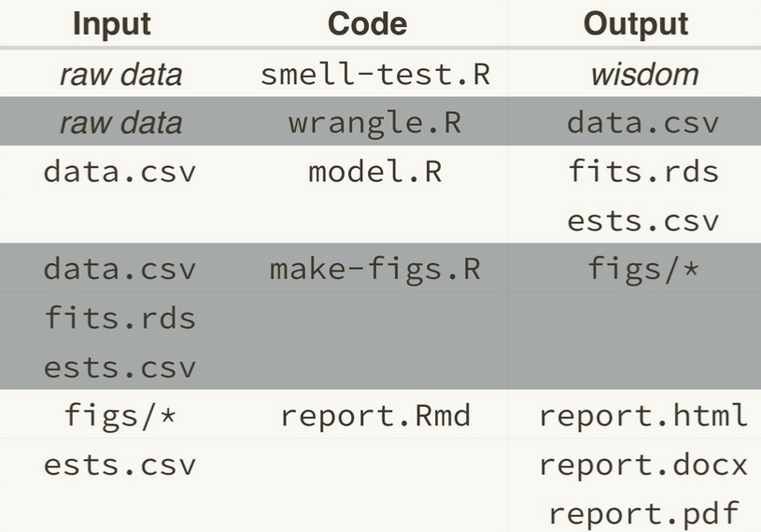
Structure of bigger analysis projects
one script for „Make Friends with your Data“ → chaos is allowed here! ☺
(numbered) scripts for defined substeps
save substeps (prepared data, models, plots,…)
put everything you still find important into a report
00_
01_
02_
03_
04_
aus „Zen And The aRt Of Workflow Maintenance” (Jenny Bryan, 2018)
Notes:
https://speakerdeck.com/jennybc/zen-and-the-art-of-workflow-maintenance?slide=57

Slide 114
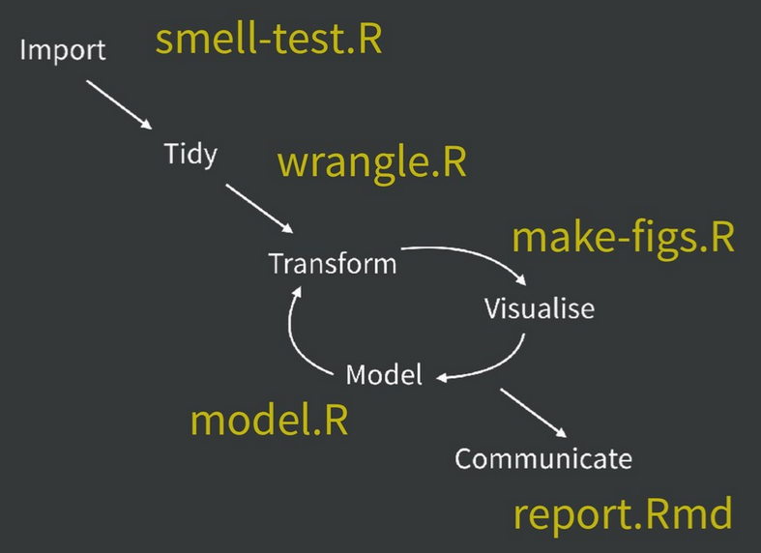
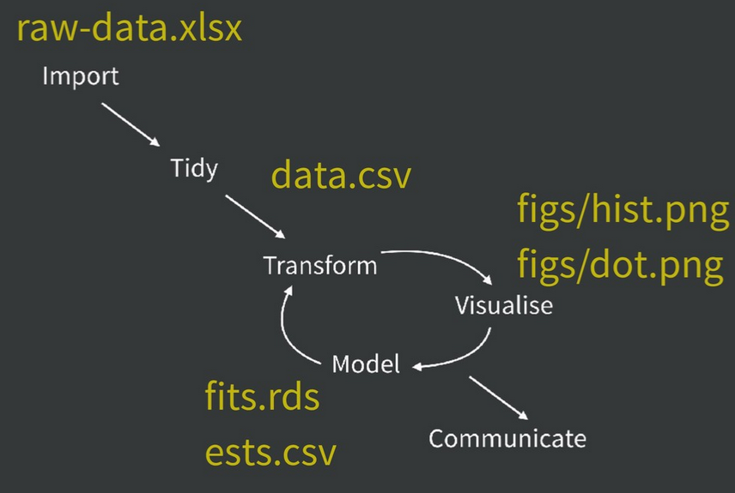

Slide 115

What‘s in a Name? That which we call a Rose
by any other name would smell as sweet.
(Shakespeare, 1595)
WRONG! Names of objects and files are very important
Naming files and things well is difficult - but worth the effort. Accurate and well-written names help others and yourself to understand and deal with the code.

Slide 116
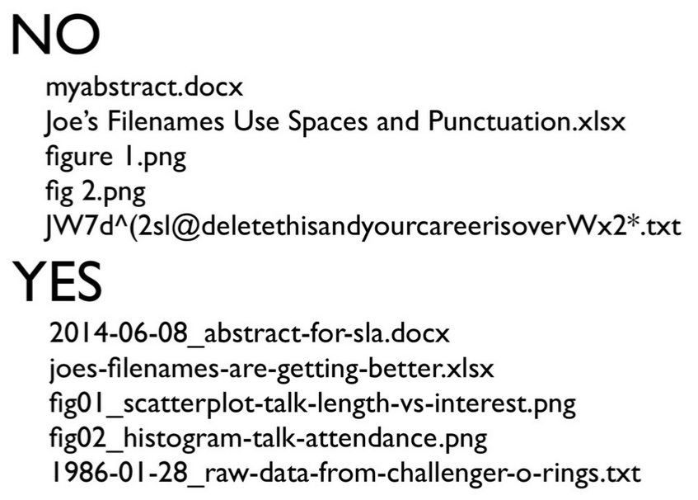
Prinzipien für Dateinamen
machine readable
avoid spaces, punctuation, accented characters, case sensitivity
deliberate use of delimiters (_, -)
human readable
name contains info on content
plays well with default ordering
put something numeric first (chronologically or logically ordered)
left pad other numbers with zeros (“fig01”)
Notes:
https://speakerdeck.com/jennybc/how-to-name-files
mit Ausnahmen auch für Objektnamen gültig (keine Zahlen am Anfang)

Slide 117


Slide 118

Directories
for smaller projects you can manage with one folder - for larger ones you usually start with one folder and regret it afterwards ☺
Tip: it is better to start too organized than to have to overturn everything afterwards
in the simplest form:
01_rawdata
02_prepared
03_results
optional:
scripts
plots
report
documentation/additional info
_process_storage (substeps)
_archive (for older versions that you do not dare to delete)

Slide 119
Problem with fixed working directories
We need to talk about setwd(„path/that/only/works/on/my/machine“)!
There are disadvantages to using the default working directory or setting your own working directories
in cooperation with other persons
when changing the PC or changing folder structures
when switching between analysis projects
Following some guidelines, setwd() is fine:
use only in obvious places (at the beginning of the script)
set to a fixed location (highest level of a project)
Notes:
https://rstats.wtf/projects.html
Beispiel: in unserer Arbeit wurde vor ein paar Jahren die Ordnerstruktur umgeworfen -> sämtliche setwd()s gingen nicht mehr; Projekte (+ deren sensible use) hätten das verhindert

Slide 120
Project-oriented workflow
File system discipline
all relevant files are stored in designated folders (data, code, graphics, notes,...)
Organization in subfolders is often useful
Working directory intentionality
the working directory in project A is always in project As folder (ideally this is not achieved by hardcoded paths in the code)
File path discipline
all paths are relative to the designated parent folder
https://rstats.wtf/projects.html
Notes:
https://rstats.wtf/projects.html

Slide 121
Projects and the here package
RStudio projects set the working directory to the location of the project
the here package recognizes the project and can output the path
Projects can also have their own settings (Tools > Project Options) or a profile (.rprofile) whose content is executed when the project is opened (e.g. to load packages)
Advantages:
no manual copying of folder paths
no search-replace with backslashes
the project runs (if used correctly with relative paths) also with other persons or on other PCs
you can easily work on multiple projects at the same time through multiple R sessions
Notes:
https://www.tidyverse.org/blog/2017/12/workflow-vs-script/

Slide 122



Creating projects

Slide 123


Small change – big effect
with setwd()
with project in a parent folder and here::here()

Slide 124
Descriptive Statistics

Slide 125
Principle
read data
Prepare data, prepare for analysis
(maybe exploration)
ANALYSIS!
save result

Slide 126
Overview
Function | Description
mean() | Mean value (arithmetic mean)
median() | Median
quantile() | Quantile
var() | Variance
sd() | Standard deviation

Slide 127
Overview
Function | Description
summary() | Summary of (any) object
psych::describe() | important characteristic values (e.g. min, max, mean value)
range() | minimum, maximum
cor() | Correlation (by default: Pearson. Kendall or Spearman are possible) Significance test for correlations with cor.test(x,y)
cov() | Covariance

Slide 128

To get an overview of data …
psych::describe()
summary()
Notes:
skimr::skim()

Slide 129
Mini-Quiz: You want to calculate the mean and SD of the variable "dose" from the dataset med. Which code is correct?
mean(dat$dosis)
mean(med$dosis)
Mean(med$dosis)
sd(med$dosis)
mean(med§dosis)
mean(med$Dosis)
mean(dosis)
library(psych); describe(med$dosis)

Slide 130
Mini-Quiz: You want to calculate the mean and SD of the variable "dose" from the dataset med. Which code is correct?
mean(dat$dosis)
mean(med$dosis)
Mean(med$dosis)
sd(med$dosis)
mean(med§dosis)
mean(med$Dosis)
mean(dosis)
library(psych); describe(med$dosis)

Slide 131

Row-by-row or column-by-column calculations
rowMeans()
colMeans()

Slide 132

Frequency tables
tab <- table()
prop.table(tab)
addmargins(tab)

Slide 133

Analyses by group
tapply(variable, grouping variable, function)
Treatment | Age
Treated | 27
Treated | 31
Placebo | 55
Placebo | 40
Placebo | 65
Mean
Mean
Notes:
mehrere Gruppierungsvariablen in list() packen.

Slide 134
Mini-Quiz: Which code is correct?
tapply(Arthritis$Age, Arthritis$Treatment, mean
tapply(Arthritis$Age, Arthritis$Treatment, mean)
tapply(Age, Treatment, mean)
tapply(Arthritis$Age, mean)
tapply(Arthritis$Age, Arthritis$Treatment, function(z) mean(z))

Slide 135
Mini-Quiz: Which code is correct?
tapply(Arthritis$Age, Arthritis$Treatment, mean
tapply(Arthritis$Age, Arthritis$Treatment, mean)
tapply(Age, Treatment, mean)
tapply(Arthritis$Age, mean)
tapply(Arthritis$Age, Arthritis$Treatment, function(z) mean(z))

Slide 136
Mini-Quiz: Which code is correct?
tapply(Arthritis$Age, Arthritis$Treatment, mean
tapply(Arthritis$Age, Arthritis$Treatment, mean)
tapply(Age, Treatment, mean)
tapply(Arthritis$Age, mean)
tapply(Arthritis$Age, Arthritis$Treatment, function(z) mean(z))

Slide 137

Exercise
Load the dataset “penguins.csv“ (read.csv2())
Generate a cross table with table() using the variables species and sex and assign the table to the tab1 or tab2 variable.
without consideration of missing values (NA) → tab1
with consideration of missing values → tab2
Generate a table with edge frequencies from tab2 (with missing values).
Generate a table of relative frequencies from tab2, rounded to 2 decimal places. Assign this table to a new variable tab3.
Convert tab3 to percentages.

Slide 138
Inference statistics

Slide 139

Tests for independence
Chi-Square Test: chisq.test()
Fisher’s Exact Test: fisher.test()
Preparation: create a crosstab. (xtabs())

Slide 140

Covariance und Correlation
cov()
cor()
cor.test()

Slide 141

T tests
stats::t.test()
One-sample T test (to test against a fixed value) t.test(x, mu = 0)
t-test for dependent samples t.test(x, y, paired = TRUE)
t-test for independent samples t.test(x ~ group, var.equal = FALSE)
Welch-Korrektur
Notes:
var.equal = TRUE
two.sided

Slide 142

T Tests
Welch Correction
Notes:
var.equal = TRUE

Slide 143
oder library(lsr)
cohensD(data_xls$Gewicht~data_xls$Geschlecht)
evtl. Cohen‘s d
library(effsize)
## data and factor
cohen.d(d,f)
## formula interface
cohen.d(d ~ f)
## compute Hedges' g
cohen.d(d,f,hedges.correction=TRUE)

Slide 144
Mini Exercise
id_student | test1 | test2
1 | 20 | 34
2 | 13 | 12
3 | 1 | 7
… | … | …
We want to know if a group of students could improve math skills by taking a course. To do this, we have a performance score from each student from a math test before and after the course. (For this purpose we want to calculate a t-test.) What is the command in R?
t.test( , , )
TRUE
true
dat$test1
==
paired
FALSE
dat$id_student
dat$test2
false
=

Slide 145
Mini Exercise 2
maus | futter | gewicht
1 | normal | 20
2 | normal | 13
3 | spezial | 19
… | … | …
We have 2 groups of mice. One group we fed normally, the other with a special diet. We would like to know if the two groups differ in weight
(For this purpose we want to calculate a t-test.) What is the command in R?
t.test( , , )
~
TRUE
true
futter
==
paired
=
FALSE
maus
gewicht
false

Slide 146

Linear Regression
mod <- lm(av ~ predictor, data = datensatz)
summary (mod)

Slide 147

Linear Regression
plot(av ~ uv)
abline(mod, col="red")

Slide 148

Save plot

Slide 149
Exercise linear regression
Load the dataset pirates.csv (read.csv2)
Calculate a linear regression with criterion weight and the predictor height. Create a plot with the regression line.
Calculate a linear regression with criterion tattoos and predictor height. To do this, create a plot with regression line.
Use a t-test to check whether male and female pirates (sex) differ in beard length (beard.length). (To do this, first restrict the data set to sex == "male" or "female").
Load the dataset bfik.sav Check if the variables sex and uni are statistically independent. (bfik$sex once contains the value 99. First, recode this to NA.)

Slide 150
Plots

Slide 151
Basically …
Plots have multiple purposes, for which different workflows are suitable.
exploratory plots: get to know data, get impression, fast, not meant for others
expository plots: plots for publications or reports
for fast, explorative graphics the standard plots of R (with base R) are suitable
for detail-oriented plots the functions from the package ggplot2 are suitable
We first look at base plots!

Slide 152
Logic of plots in R
Plots in base are applied in three layers:
Graphic parameters (layout, size,…)
high-level plot functions (scatterplot, bar diagram, histogram,…)
low-level plot functions (linies, dots, legend, titles,…)

Slide 153

Graphics parameters
The graphic parameters determine the "canvas" on which the plot is mapped.
layout, size,…

Slide 154

High-Level plot functions
These functions determine the plot type. The application of such a function causes a new plot to be drawn.
scatterplot, bar diagram, histogram,…

Slide 155

Low-Level plot functions
Low-level plot functions are "painted" or added to existing graphics.
lines, dots, legend, titles,…

Slide 156
First plots in R
Function | Description
plot() | context-dependent, generic function
barplot() | Bar diagram
boxplot() | Boxplot
hist() | Histogram
density() | Density distribution
The function plot() is generic and can be used on different types of objects.
Depending on the input plot() draws different diagrams.

Slide 157

Procedure for the creation of plots
plots are built up step by step in the script
par() sets plot parameters
To save plots, you use various graphic devices with the functions: pdf(), png(), jpeg(), bmp(), tiff() before the plot functions and dev.off() after

Slide 158
Plot parameters
Parameter | Description
axes | Axes should (not) be drawn
bg | Background color
cex | Size of a dot / letter
col | Colors
las | Alignment, axis labeling
lty, lwd | Line type, line width
main, sub | Title, subtitle
mfcol, mfrow | multiple plots in one image
pch | Symbol for a dot
type | Type (l = line, p = dot, b = both, n = nothing)
xlab, ylab | Axis labeling
xlim, ylim | Limits for axes
the following parameters can be used with par() or in plot functions:

Slide 159


Plot parameters: symbols and lines
plot(dose, drugA, type="b", lty=3, lwd=3, pch=15, cex=2)

Slide 160
Plot parameters: colours
Colours can be displayed with index, name, hexadecimal representation, as RGB (red, green, blue) or HSV (hue, saturation, value): col=1, col="white", col="#FFFFFF", col=rgb(1,1,1), col=hsv(0,0,1).
with the functions colors() you can view all possible colours.
Additional functions generate vectors with color schemes: e.g.: rainbow(), heat.colors()...
scales::show_col() can display colors in the viewer window
List with all colors at: http://research.stowers.org/mcm/efg/R/Color/Chart/ColorChart.pdf
wesanderson Package: https://github.com/karthik/wesanderson

Slide 161
low-level plot functions
Parameter | Description
abline() | Line
arrows() | Arrows
axis() | Axes
grid() | grid
legend() | legend
lines() | lines (step by step)
points() | points
polygon() | (filled) polygons
pretty() | better division of the axes
text() | text
title() | Labeling
After a plot is generated, low-level functions can be used to add and modify text, titles, legends and axes.

Slide 162

Combination of plots
The functions par(), layout() enable the mapping of multiple plots simultaneously.
par(mfrow=c(nrows, ncols)): Fill row by row
par(mfcol=c(nrows, ncols)): Fill column by column, z.B.
par(mfcol=c(1, 2)) results in two graphics side by side
layout(mat): Matrix contains coordinates of the individual plots

Slide 163

Scatterplots
Scatterplots are created by plot(x, y) and show the correlation of two variables.

Slide 164

Bar diagrams
Bar diagrams are created with barplot(height) and are important for representation of frequency distributions(table()) with categorical data.

Slide 165

Bar diagrams – new arguments

Slide 166

Bar diagrams – multidimensional matrices / data frames

Slide 167

Histograms
Histograms are created with hist(), density() and are used to represent distributions for continuous variables.

Slide 168

Histograms
Histogram with a Rug Plot and Density Curve

Slide 169

Density Plots

Slide 170

Boxplots
Box-and-whiskers Plots graphically show the five-number statistic: min, lower quartile, median, upper quartile, max (boxplot.stats()).
Boxplots require the formula notation y ~ A*B.

Slide 171
If this is not enough: ggplot2
What is ggplot2?
ggplot2 is a popular package for creating plots. It is more flexible than base-graphs, but also needs a little more training.
ggplot2 is based on the grammar of graphics, the idea that every plot consists of the same components: a data set, geometric elements and a coordinate system (more on that here: Wickham, 2010).
Compared to base plots, ggplot2 plots require a bit more code, but are customizable in all details.
While base plots are displayed immediately, ggplot2 plots are objects that are customizable.
ggplot2 works best with tidy data, i.e. each row is an observation and each variable is a column (see Wickham, 2014)

Slide 172

Syntax of ggplot2
ggplot() +
geom_*(aes()) +
stat_*() +
coord_*() +
facet_*() +
scale_*_*() +
theme_*()
Cheatsheet here: https://www.rstudio.com/resources/cheatsheets/

Slide 173

Syntax of ggplot2 (Example)

Slide 174






The most common geom functions
Function | Description | Pic
geom_bar(); geom_col() | Bar chart - e.g. frequency of categorical expressions
geom_point() | Scatterplot - Relationship between two continuous variables
geom_smooth() | Fit line for a scatterplot, e.g. linear regression or smoothing
geom_line() | Line chart - e.g. change over time
geom_abline(); geom_hline(); geom_vline() | single lines (diagonal, horizontal, vertical), e.g. as reference
geom_histogram() | Histogram - distribution of a variable
geom_violin() | Violinplot - distribution of a variable grouped by categories
geom_boxplot() | Boxplot - distribution of a variable grouped by categories

Slide 175
Most common other functions
Function | Description
theme_set(theme_bw()) | Fix the theme for the upcoming plots (in this case theme_bw())
coord_equal() | x- and y-axis get the same coordinate system
coord_flip() | Switch x- and y-axis (e.g. for long labels)
facet_grid(~ variable) / facet_wrap() | Split plot according to one or more categorical variables
scale_x_continuous(breaks = …, limits = …) | Boundaries and hyphens for coordinate axes (also works with y)
scale_fill_manual() | determine own colors for fill aesthetics

Slide 176
other useful functions
Function | Description
annotate() | single note in the plot (e.g. correlation, p-value,...)
labs(title, subtitle, caption, x, y, fill,…) | Title for the plot, the axes, the signature…
theme(legend.position = „none“) | Remove legend
theme(axis.text.x = element_text(angle = 90)) | Rotate text, in this case labeling the x-axis by 90°.

Slide 177
Help for Plots
base:
R Cookbook: http://www.cookbook-r.com/Graphs/
R Base Graphics - An Idiot's Guide: https://bit.ly/2YrlDg8
The Base Plotting System in R: https://bit.ly/2UVxFMH
ggplot2:
ggplot2-Homepage: https://ggplot2.tidyverse.org/index.html
ggplot2-Cheatsheet: http://www.rstudio.com/wp-content/uploads/2015/03/ggplot2-cheatsheet.pdf
Package: ggpubr for publication ready plots (https://rpkgs.datanovia.com/ggpubr/)
Kapitel "Data visualisation" in "R 4 Data Science": https://r4ds.had.co.nz/data-visualisation.html
Kieran Healys "Data Visualization - A practical introduction": http://socviz.co/
both:
R Graph Gallery: https://www.r-graph-gallery.com/
Notes:
http://www.sthda.com/english/wiki/ggplot2-title-main-axis-and-legend-titles

Slide 178
Exercise – Plots
Create a colored bar chart with legend from tab1 (from the last exercise).
Load the dataset zuf.sav and create a histogram of the variable swls and a density plot (package car) of the variable fs. Both graphs should appear side by side in one window.
Load the data set data(WorldPhones) with data(WorldPhones); dat <- WorldPhones. In it, find the number of landlines between 1951 and 1961 in 7 world regions. Create a common barplot for North America and Europe that shows the progression over the years, using different colors for them.
(Choice between base and ggplot2 - bonus points if both are used!)

Slide 179
Exercise – Plots
we read the dataset penguins with
penguins <- palmerpenguins::penguins (install.packages(„palmerpenguins“), if not yet available)
Explore the data set and some questions that come to mind about it using plots.
Afterwards, feel free to switch to your own data sets and explore them with plots.

Slide 180
Reporting with RMarkdown

Slide 181
What is RMarkdown?
R Package
Reports can be created (e.g. as PDF or HTML).
They contain R code and can calculate and update their own content.
Advantage: easily adaptable, e.g. to new data.
file format: .Rmd or .Qmd
You need:
Packages: rmarkdown, knitr
maybe further packages (e.g. kableExtra for tables)
.Rmd file
maybe. LateX, pandoc (is usually installed automatically)

Slide 182



Elements of an .Rmd file
Options for code block
YAML header
Comments
<!-- in text-->
# in code
Code Block
Text with headings

Slide 183

„Knitting“ an RMarkdown makes a PDF (or…)

Slide 184


Slide 185

Source Editor

Slide 186

Visual Editor
The Visual Editor brings R Markdown closer to WYSIWYG text editors such as Word. The most common formatting options are selectable by mouse click.
Notes:
https://rstudio.github.io/visual-markdown-editing/
https://bookdown.org/yihui/rmarkdown-cookbook/rstudio-visual.html

Slide 187
Demo: Rmd File
Rmd Template
YAML Header mit Menü verstellen (output format)
Knit Button
Überschriften und Ebenen
Kommentare <!-- Kommentar-->

Slide 188
Programming in R

Slide 189


for loops
One would like to repeat commands
for loop for(looping variable in area) {LOOP.CODE}
while loop while(looping variable in area) {LOOP.CODE}
You want to execute commands only under certain conditions
if loop

Slide 190

for loops
for loop to create multiple plots. for(looping variable in vector) {LOOP.CODE}

Slide 191

Loops

Slide 192
Mini Exercise 1
We want to output the numbers 2 to 5 to the console. For this we want to use a loop. What is the command in R?
for( ) { print( ) }
~
in
7
ii
1:5
2:5
1
b
==
ii
a

Slide 193
Mini Exercise 2
maus | futter | gewicht
1 | normal | 20
2 | normal | 13
3 | spezial | 19
… | … | …
We want to output a histogram of each of the variables food and weight? For this we want to use a loop. What is the command in R?
for( ) {hist( ) }
futter
7
2:5
c(„futter“, „gewicht“)
dat[, ii]
in
1
==
ii
a
ii

Slide 194

if loops
You want to execute commands only under certain conditions
if loop else if else
if(condition) {LOOP.CODE} else {
ALT.CODE}
if(condition1) {LOOP.CODE} else if (condition2) {
ALT.CODE} else {OTHER.CODE}

Slide 195
Examples
if(x > 0){
print("Positive number")
}
if statement
if…else statement
if…else ladder
if(x > 0){
print("Non-negative number")
} else {
print("Negative number")
}
if(x < 0){
print("Negative number")
} else if(x > 0) { print("Positive number")
} else {
print("Zero")}

Slide 196
apply functions
Apply functions can be used instead of for-loops (and are often but not always faster):
apply(data, direction, function): for data frames, matrices and arrays.
lapply(list, function): for lists and vectors (output = list)
sapply(list, function): for lists and vectors (output = simplified structure)
tapply(data, groups, functions): for groups (output = table)

Slide 197

lapply function

Slide 198
Struktur: apply(Daten, Richtung, Funktion)
Richtung: 1=zeilenweise, 2=spaltenweise, ... beliebig erweiterbar für Arrays mit höheren Dimensionen
Hier wird für jede Spalte (MARGIN = 2) der minimale Wert (min) ermittelt. Zusätzliche Argumente (na.rm=TRUE) werden einfach angehängt.

Slide 199

Principle: apply(data, direction, function)
direction: 1=row wise, 2=column wise
Example: Here the minimum value (min) is determined for each column (MARGIN = 2). Additional arguments (na.rm=TRUE) are simply appended.

Slide 200
Exercise
Calculate the square of the numbers 1 to 10. Use a for loop and display the respective number and its square.
Create a vector with the numbers 1 to 10. Randomly draw a number from it (sample(vector, 1)). Print the drawn number. Check with if()..., whether the drawn number is less than 5 and output "The number is less than 5.".

Slide 201
Debugging

Slide 202


Slide 203

Basis Rules when errors occur
stay calm
see if an error message has occurred before
try the same again
restart R and then try again (Session > Restart R)
Break the problem down into small parts: where does R get stuck?
am I giving the function what I expect? View data, view substeps
for nested functions, execute the interior individually
Recreate function with simpler data
look up examples of the function (F1, ?function oder help(„function“)) and look for differences in the application
https://speakerdeck.com/jennybc/object-of-type-closure-is-not-subsettable
Notes:
https://speakerdeck.com/jennybc/object-of-type-closure-is-not-subsettable

Slide 204

Rubber duck method
https://en.wikipedia.org/wiki/Rubber_duck_debugging
Talk to a friend or colleague (or even a rubber duck) and explain your code to them. They don‘t need to understand it or solve your problem. By explaining the code line by line you might discover the problem by yourself.

Slide 205
Common error messages and their meaning
Error message | Description | common solution
Error: object ‚…‘ not found | something was executed that is not present in the environment | check whether the requested object is in the environment. If not, assign again. Often this error is not the cause, but the consequence of an error above.
Error: could not find function „…“ | Function cannot be found | Package is not loaded (→ library()) or function has a typo. Load package or refer to it directly in function package::function; check for typos.
Error: unexpected numeric constant in „mean(c(1. 4.“ | R finds a number where it does not expect it | Are all commas, brackets, etc. where I want them? The numbers should have been separated by commas, not a period. "Unexpected..." also often comes up with typos, spaces,....
Error: incorrect number of dimensions | Indexing hits different dimensions than expected | Is what I want to index in the structure I expect? e.g. my_df$variable[,] Through the $ my data frame becomes a vector and therefore does not need a comma in the square brackets anymore
Error in file(file, „rt“): cannot open the connection | a file cannot be found | File path is wrong or there are no read rights to the file, is getwd() where I expect it?
Error: object of type closure is not subsettable | type closure = function | Here R interprets something as a function that is not a function. Occurs when e.g. square brackets are confused with round brackets: mean[] (function "mean" can not be indexed)
R is not ready (>) | R does nothing despite running lines | R is either ready for new code (> in the console) or waiting for more code (+ in the console) Here a closing bracket is often missing ) or } Wait status can be canceled by pressing Esc
Notes:
https://bookdown.org/ndphillips/YaRrr/debugging.html

Slide 206
Thanks for your attention!
Gabriele von Eichhorn, MSc BSc BA
IQS – Institut des Bundes für Qualitätssicherung im österreichischen Schulwesen
gabi.v.eichhorn@gmail.com / gabriele.eichhorn@iqs.gv.at

